Slide 1
Avoiding Common Pitfalls with Async/Await
Stephen Cleary
Notes:
Questions welcome!

Slide 2

Who is this guy?
Notes:
Available for contract work!
Microsoft MVP
Top async/await answerer on Stack Overflow
Assisted hundreds of companies with async adoption across all kinds of applications (available for contract work!)
Blog has been the go-to source for async advice for years
Contributor of some of the MS documentation on subjects such as ValueTask
Maintainer of AsyncEx, a library with >25M downloads which provides asynchronous coordination primitives and other async helper types

Slide 3


Slide 4
Conceptual Mistakes

Slide 5
Confusing Parallel and Async

Slide 6
Confusing Parallel and Async
Concurrent
Multithreaded
Asynchronous
Parallel
Notes:
This slide is mostly about terminology, and there’s no definite standard or consensus yet.
I prefer to use the term “concurrency” for multiple things happening at the same time.
UI example, server example.
Multithreading is one way to get concurrency.
“Parallelism” is parallel processing, one type of multithreading.
Asynchrony is a way to get concurrency without multithreading.

Slide 7
Confusing Parallel and Async
But some things do cross over:
Parallel.ForEachAsync / Parallel.ForAsync
Fork/join (Task.WhenAll) resuming on thread pool threads can cause parallelism.

Slide 8
Using Async to “go faster”

Slide 9
Using Async to “go faster”
Client | Server
Primary benefit: Responsiveness | Primary benefit: Scalability
Keep UI thread free | Minimize threads used to serve requests
Better UX | 10x-100x scalability (same box)
Required by many app stores | Faster response to bursting traffic
Notes:
The benefits for client and server are different, but both come from the same core: freeing up threads. (Not using more threads).

Slide 10
Conceptual Correctness (?)

Slide 11
Correctly conceptualizing Async (1)
“await”: “asynchronous wait”
Task represents the method’s execution.
Completion
Results
Exceptions
await can pause a method’s execution.
Notes:
This is my default conceptualization, and the one I describe when first teaching async/await.

Slide 12
Correctly conceptualizing Async (2)
Types: “wapper” / “unwrapper”
Task<T> wraps the result of an async method Task<T> is a future value of T async “wraps” future values into Task<T> await “unwraps” the future value from the task
(hint: async is a monad in functional languages)
Notes:
This conceptualization is useful when you are doing something functional and you need to figure out your types.

Slide 13
Correctly conceptualizing Async (3)
Callbacks
async chops up the method into a state machine, similar to the yield keyword
await identifies the dividing points where the method is chopped up
When await yields, it registers the next method chunk as a callback on the task
At runtime, the code stack inverts!
Call stack is not where your code came from; it’s where it’s returning to!
(and this is how the GC isn’t confused)
Notes:
This conceptualization is how async actually works, and explains how the GC works with async and why your call stack is “reversed”.

Slide 14

Demotime!

Slide 15
Usage Mistakes

Slide 16
Avoid Async Void
void is not a natural type for async methods:
Doesn’t represent execution.
No way to detect completion.
Awkward error handling.
Purpose: async event handlers.

Slide 17
Blocking on Async Code
Can cause deadlocks
https://tinyurl.com/AsyncAllTheWay
When await pauses a method, it captures a context (SynchronizationContext / TaskScheduler), and resumes the method in that context.
Some contexts only allow one thread at a time.
Thread pool exhaustion
Blocking on async code uses a thread pool thread and then requires another thread pool thread to unblock!

Slide 18
Adding unnecessary callbacks
Old code:
void DoSomething(Action onComplete) { …; onComplete(); } A(); DoSomething(() => B());
New code:
Task DoSomethingAsync() { …; } A(); await DoSomething(); B();

Slide 19
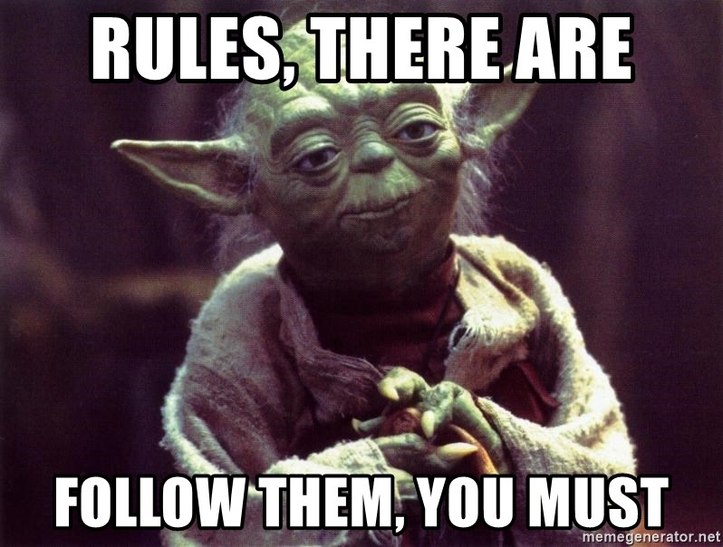
Rules Around ValueTask
Only consume once!
await – the 99% case.
Advanced: IsCompleted for fast path.
Cannot block!
.Result and .GetAwaiter().GetResult() will compile but may fail at runtime.
Even worse, they may work at runtime (block) and then later fail at runtime.
Need to bend the rules? AsTask()

Slide 20
Not Invented Here (actually more like “I didn’t know!”)

Slide 21
Cancellation
CancellationTokenSource – controls a CancellationToken
CancellationToken – used to detect cancellation.
ThrowIfCancellationRequested
Register(delegate)
Seldom used directly.
Notes:
Usually, just pass CancellationToken to next method in the chain.

Slide 22
Progress Reporting
IProgress<T> - a “sink” for progress updates.
Progress<T> - built-in implementation.
Others, too!
Your own. E.g., for throttling UI updates.
Notes:
Each progress update is of type T.
The built-in implementation is great for UI but isn’t intended to be used everywhere.

Slide 23
Pipelines (ETL)
Use System.Threading.Channels if possible.
(Use TPL Dataflow if you need all the bells and whistles).

Slide 24
Demotime!
Notes:
Cancellation / Progress Reporting
Pipelines

Slide 25

Q&A
Go forth and be awesome!
Image from Etsy user Rosewine; used with permission

